Slide 1
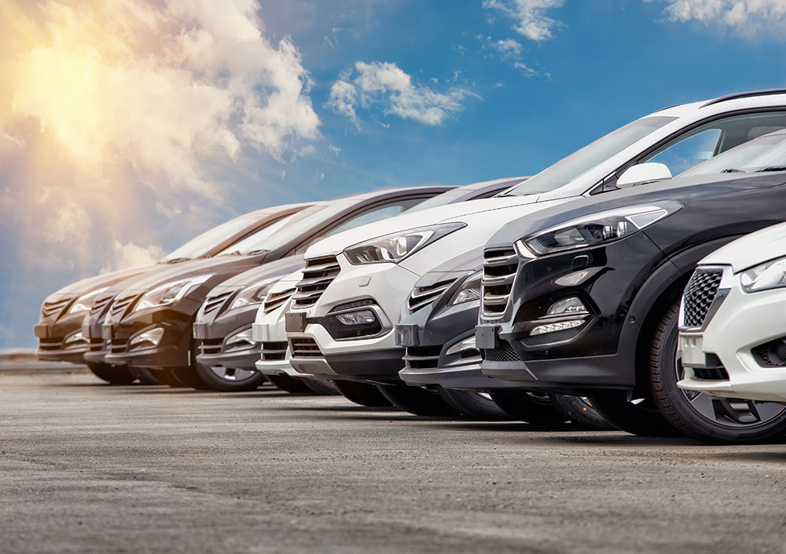
GROUP 4
USED-CARS
SHOWROOM
NAMES: ALI JAAFAR - HUSSAIN ALI - ISLAM NASSER

Slide 2
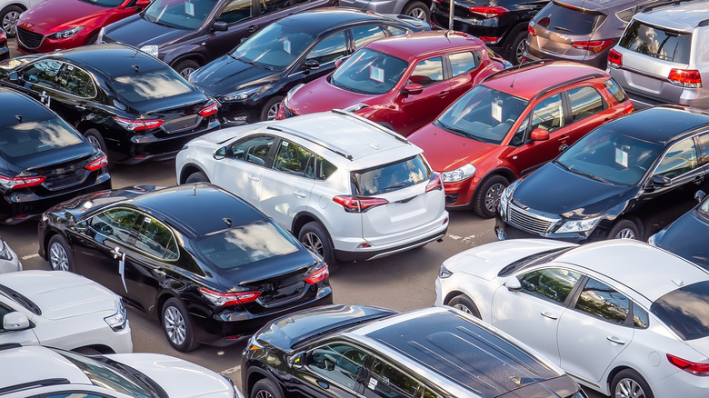
INTRODUCTION

Slide 3
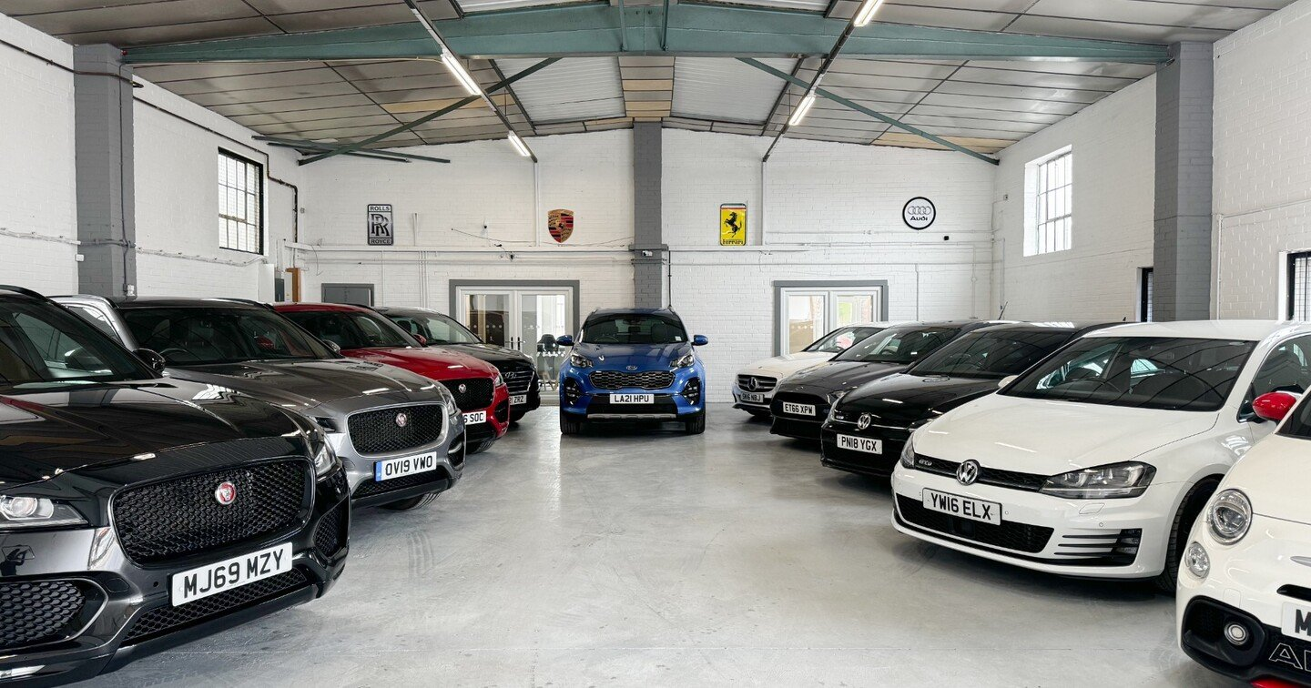
Auto Express Heaven
At A.E.H, we specialize in offering pre-owned vehicles that combine reliability, affordability, and peace of mind. Unlike traditional used car dealers, we meticulously inspect every car in our inventory to ensure it meets strict quality standards, so our customers drive away with confidence.

Slide 4
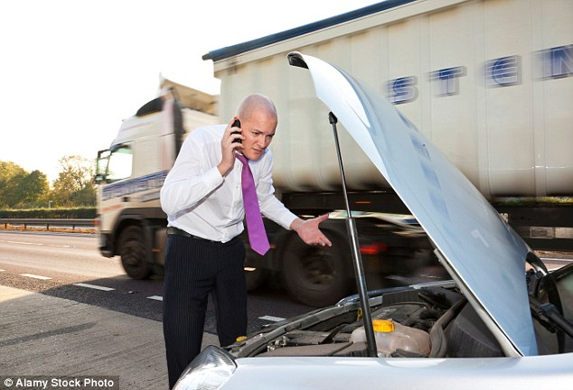
PROBLEM STATMENT

Slide 5
key challenges:
predicting high-demand models (to avoid overstocking)
Reducing slow-moving inventory
Setting optimal prices.

Slide 6

AIM

Slide 7
Popularity Trends: Which Make-Model-Year combinations have the highest/lowest popularity scores?
Fuel Efficiency Impact: Do highway/city MPG values affect popularity?
Performance Demand: Are higher Engine HP or Cylinders linked to faster sales in specific Vehicle Sizes?

Slide 8

KEY FINDINGS

Slide 9

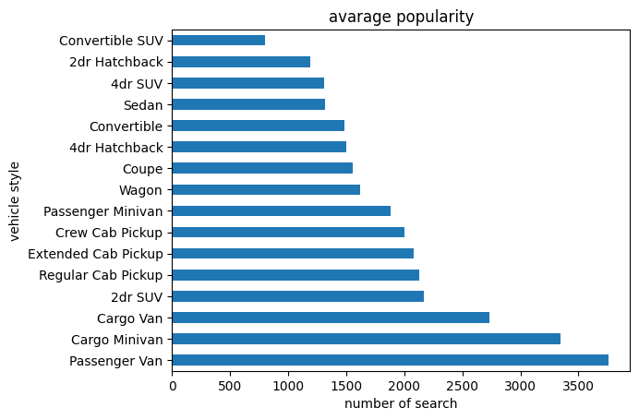
Most Car styles searched for

Slide 10
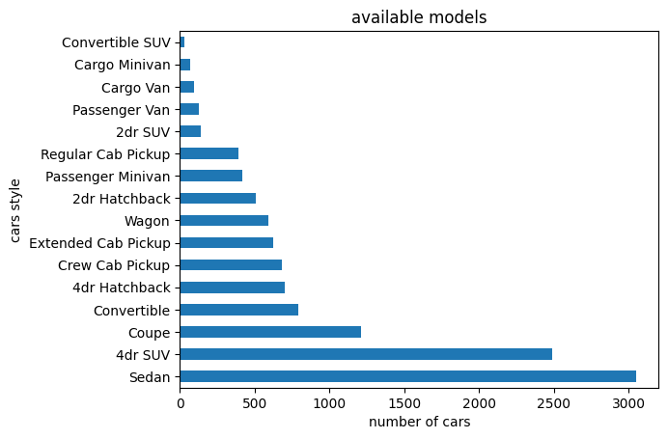
Car styles Inventory count

Slide 11
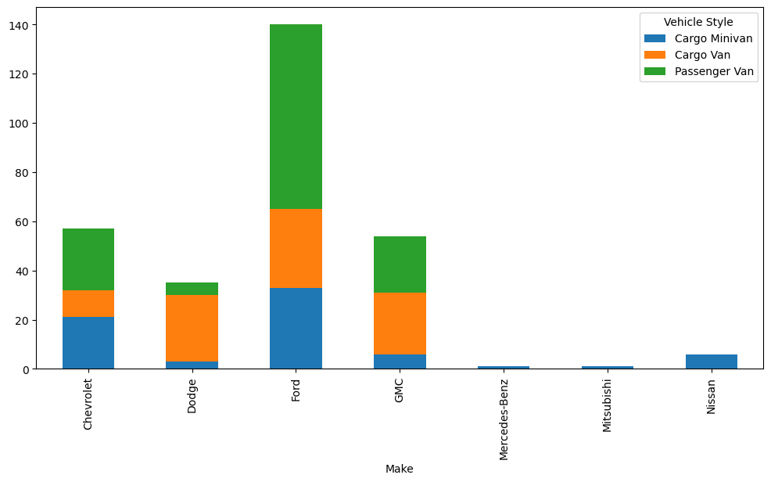
The Suppliers for the Targeted Car Styles
Cars
Manufacturer Companies

Slide 12

CONCLUSION

Slide 13
Recmmonded actions
Maintain Proven Brands/Styles:
• Sedan
• 4 Doors SUV
Prioritize High-Demand Styles:
• Passenger van
• Cargo van
• Cargo minivan
Dynamic Rebalancing:
Monthly review of sales data to adjust stock levels

Slide 14
Conclusion
Our data study shows unexpected market trends that contradict the popular understanding of the sedans domination on the roads. We've found key opportunities to improve our car selection over initial observations by carefully looking at actual sales trends and inventory turnover rates. This data-driven strategy reveals hidden opinions and possible profits that are not visible through simple observation.

Slide 15
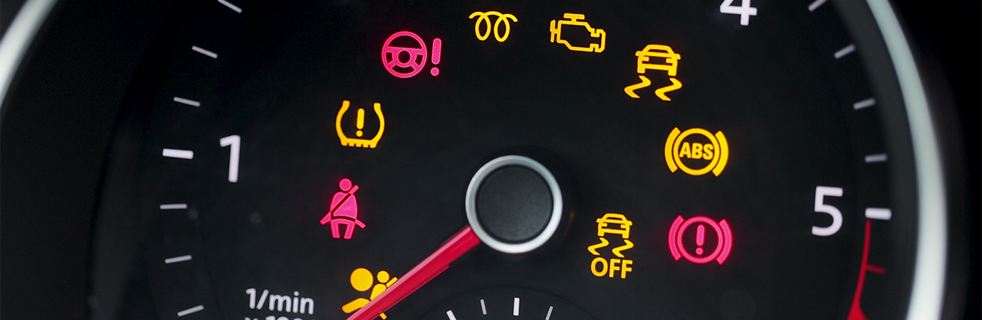
LIMITATIONS
/
OPPURTUNITEIS

Slide 16
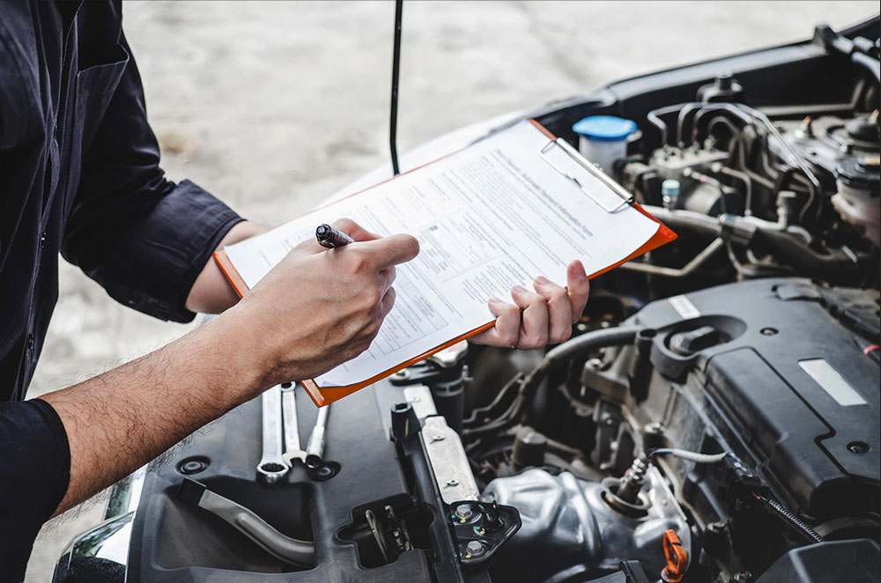
We can enhance our findings with:
✓ Accident history
✓ repair records
✓ Verified mileage
✓ market price comparisons
✓ Customer reviews
✓ inventory age data
Every upgrade delivers more transparent, reliable pricing for buyers and sellers

Slide 17


THANK YOU
FOR YOUR ATTENTION

Slide 18

Any Q????

